Slide 1
Regression Data Analysis
Airbnb Dynamic Pricing
Authors:
STUDENT NAME | REG NUMBER | STUDENT NUMBER
OGWENO WASHINGTON ODHIAMBO | 2024/HD05/21955E | 2400721955
OCHALO DEOGRATIUS | 2023/HD05/20127U | 2300720127
Presented by -
Affiliation: Makerere University
Uganda

Slide 2
1.0 Introduction
The Airbnb platform has transformed the hospitality industry by allowing property owners to rent out their homes or apartments to travelers. One of the key factors influencing both hosts’ profitability and guests’ satisfaction is the pricing strategy. Traditional pricing models often struggle to adapt to changing market demands, resulting in less than ideal pricing decisions. However, With the increasing availability of large-scale data and advancements in machine learning (ML), there is an opportunity to develop dynamic pricing models that can adapt to real-time conditions and accurately predict the optimal price for a listing.
Notes:
The dataset can be found here.

Slide 3
2.0 Background
The utilization of machine learning (ML) in pricing problems has been widely recognized in various industries such as retail, transportation, and hospitality. Specifically, in the context of Airbnb, dynamic pricing involves the utilization of historical and real-time data to forecast optimal pricing for rental listings. The challenge arises from the multitude of factors that impact property prices, including demand fluctuations, location, seasonality, and competition from other listings.
Notes:
The dataset can be found here.

Slide 4
3.0 Literature Review
The utilization of machine learning in pricing is a practice that is well-established with numerous studies delving into the realm of dynamic pricing.
Various supervised learning techniques, including linear regression, random forests, and lasso regression, have been widely employed for regression-based pricing analyses.
These models rely on historical data containing labeled prices to forecast future pricing based on a number of input variables
Notes:
The dataset can be found here.

Slide 5
4.0 Gaps, significancy of work
Gaps in Current Research
Despite the significant advancements in dynamic pricing, there are still several challenges that have not been fully explored:
Lack of real-time adaptability in current models. Previous research has primarily focused on utilizing historical data to make static price predictions, which may not be suitable for rapidly changing markets.
Ethical considerations related to AI, such as transparency and fairness in pricing decisions, have often been overlooked.

Slide 6
5.0 Project scope
To analyze the factors influencing dynamic pricing for Airbnb listings in New York City.
To develop predictive models for pricing strategies.

Slide 7
6.0 Problem statement
The dynamic pricing model in the short-term rental market, such as Airbnb, is crucial for maximizing revenue for hosts while ensuring competitive pricing for guests during fluctuating demands, seasonal variations, and local market conditions.
The goal of this project is to develop a dynamic pricing algorithm that leverages historical data, market trends, and real-time factors and recommend optimal pricing strategies for Airbnb listings.

Slide 8
ML Research Objectives
Dynamic Pricing Strategy Development:
Design and implement dynamic pricing algorithms that adjust prices in real-time based on market conditions, competitor pricing, and historical booking patterns.
Assess the performance of these algorithms in maximizing occupancy and revenue compared to static pricing models.

Slide 9
Research Questions
How can historical booking data be leveraged to optimize the pricing strategy for Airbnb listings?
How accurately can we predict demand for specific properties based on location, competition, and market trends?
What machine learning techniques provide the best predictions for occupancy rates?
What is the impact of dynamic pricing on overall revenue for Airbnb hosts compared to static pricing models?
Which algorithms perform best in predicting optimal pricing for Airbnb listings?

Slide 10
Dataset Description
Dataset contains information about Airbnb listings in New York City for the year 2019
Datasource: https://github.com/Ajitesh27/New-York-Airbnb-Data-Analytics-and-Price-Prediction.git.
2. Attributes:
id:
name:
host_id:
host_name:
neighborhood_group:
neighborhood:
latitude:
longitude:
room_type:
price:
minimum_nights:
number_of_reviews:
last_review:
reviews_per_month:
number_of_host_listings
availability_365:

Slide 11
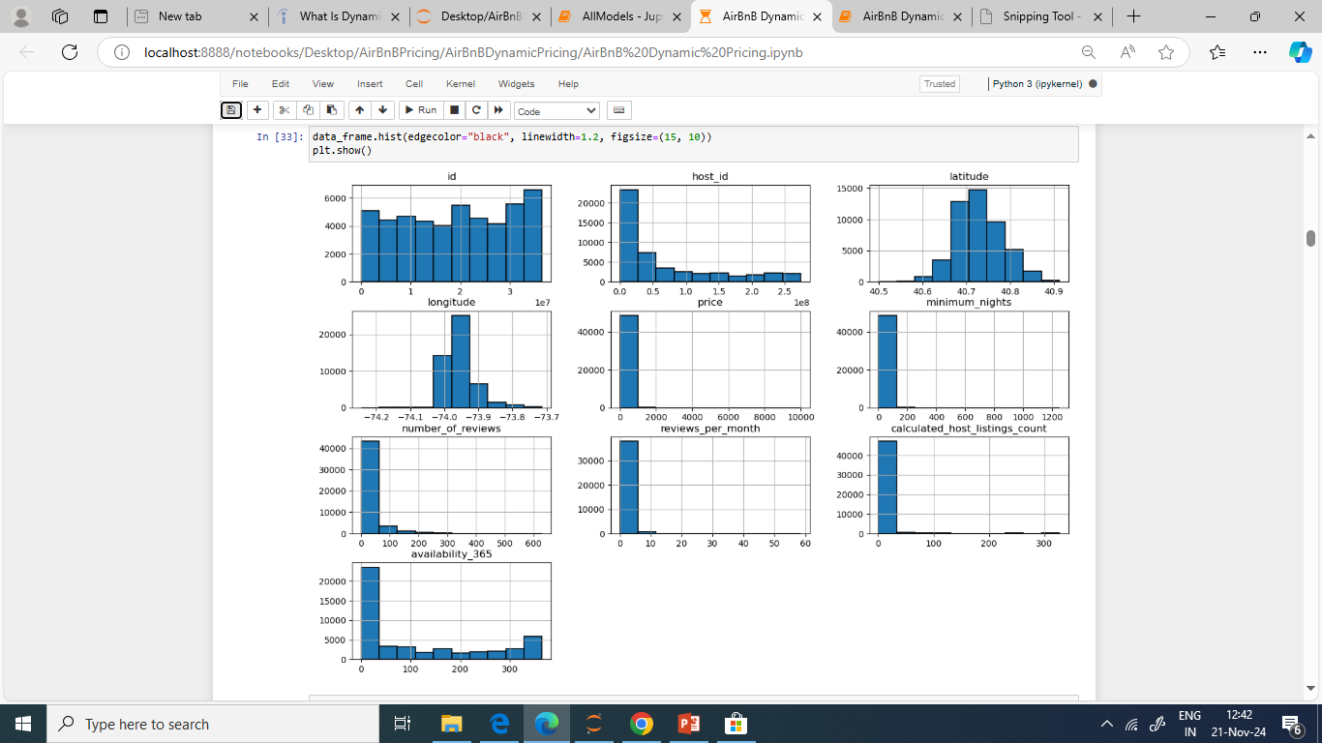
Exploratory Data Analysis
Histogram showing the distributions
The skewed histograms show a possibility of outliers in the dataset

Slide 12
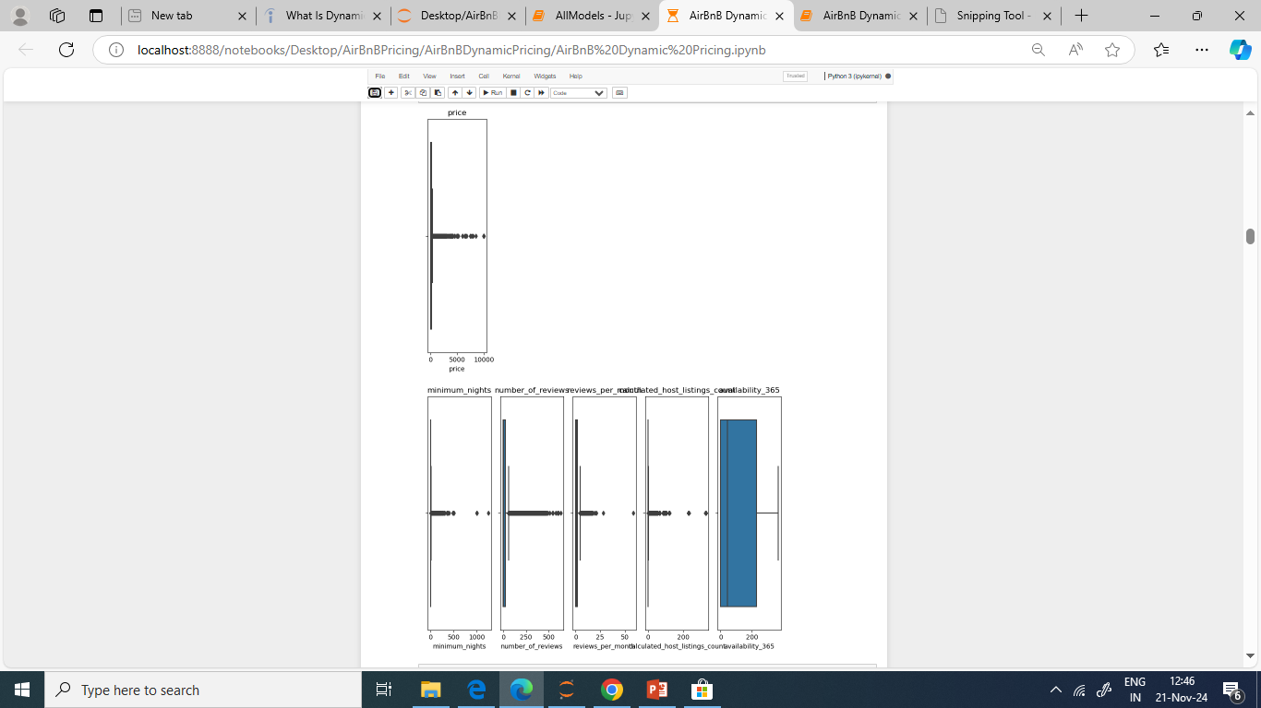
Boxplot showing outliers
BoxPlots to show the existence of outliers
The boxplots show that price, minimum_nights,number_of_reviews, reviews_per_month and number_of_host_listings are having outliers

Slide 13
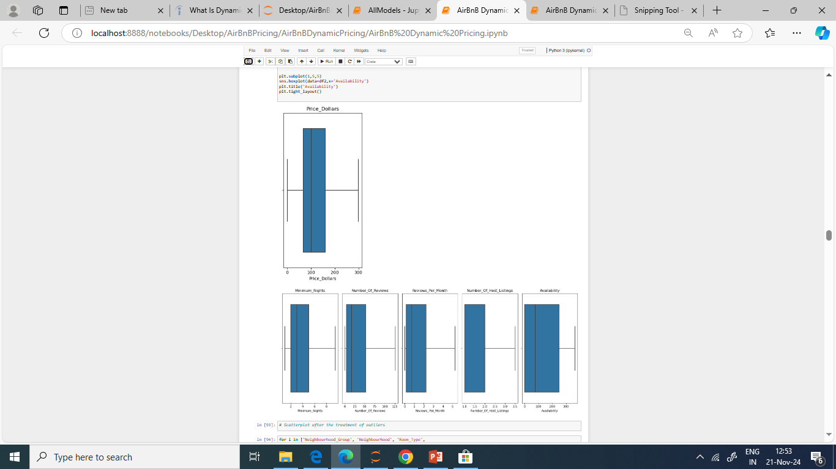
Boxplot showing outlier treatment
BoxPlot After treatment of outliers

Slide 14
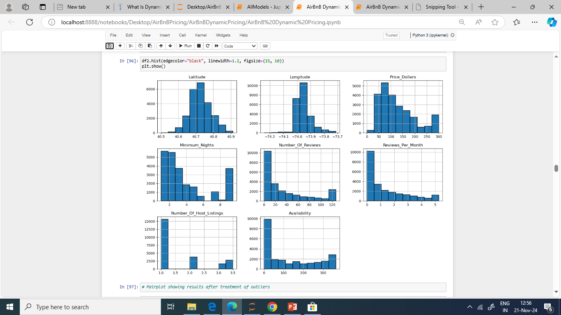
Histogram after outlier treatment
Histogram after treatment of outliers

Slide 15
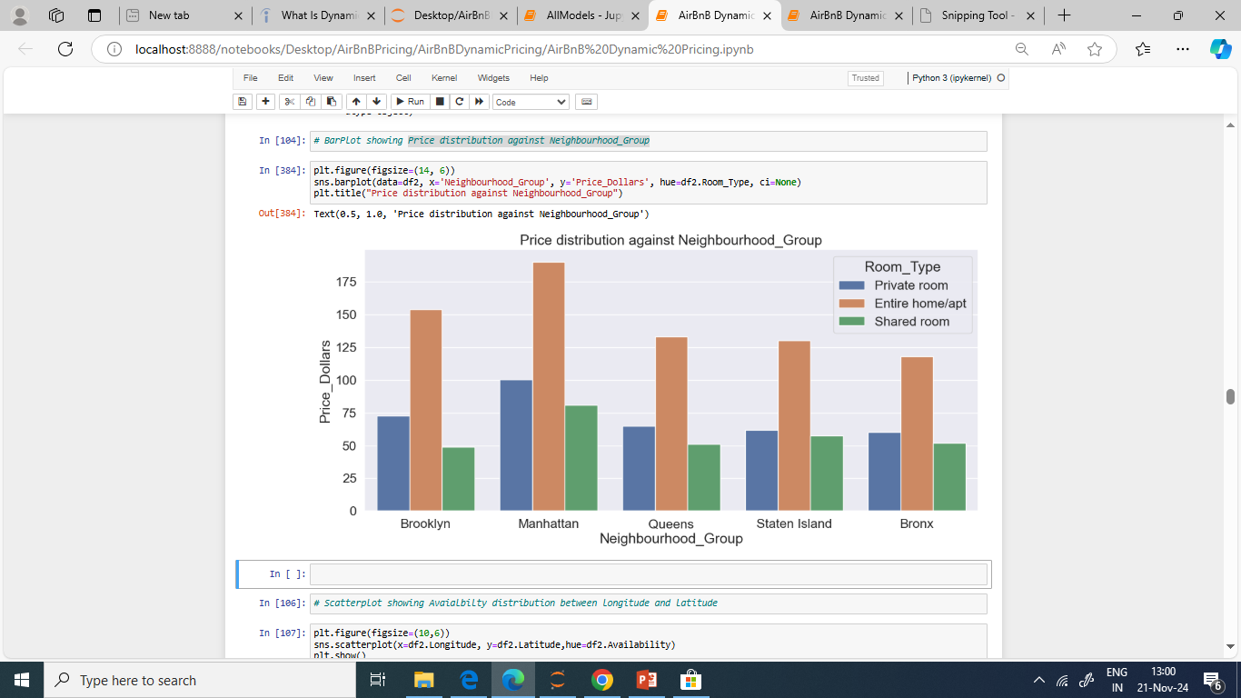
Categorical data analysis
The Neighbourhood_Group distribution shows that manhattan has more bookings followed by Brooklyn,queens,staten island and then Bronx respectively

Slide 16
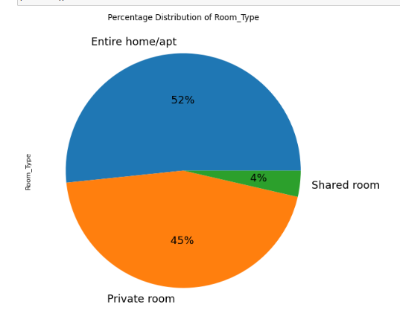
Pie-chart showing Percentage distribution of Room_Type
The pie-chart shows that 52% of people book the entire home or apartment
45% book a private room
And then 4% book a shared room

Slide 17
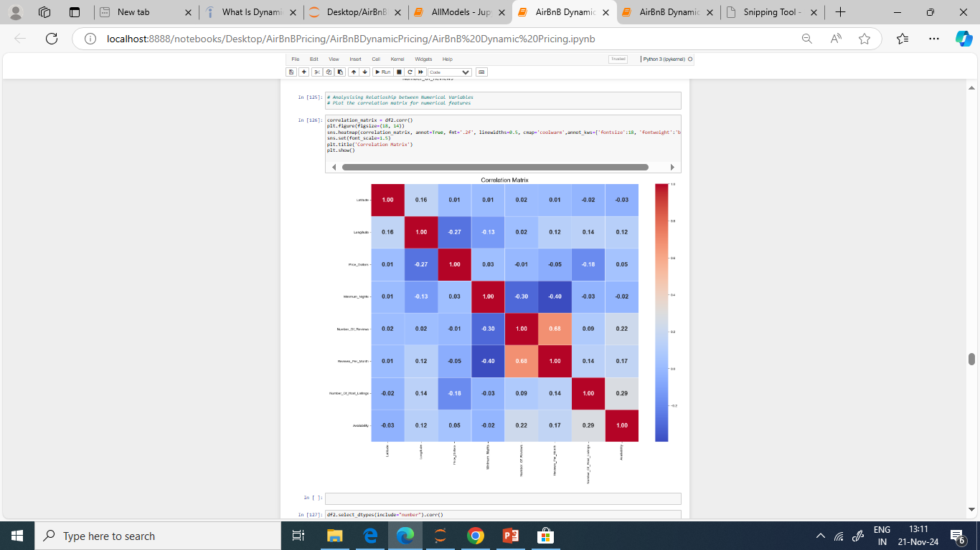
Correlation Matrix
The correlation matrix shows that most of the features have either a poor positive correlation or a poor negative correlation matrix.
With the results displayed, there is a likelihood of the trained models to be either overfitting or underfitting.
This makes the dataset not perfect for training.

Slide 18
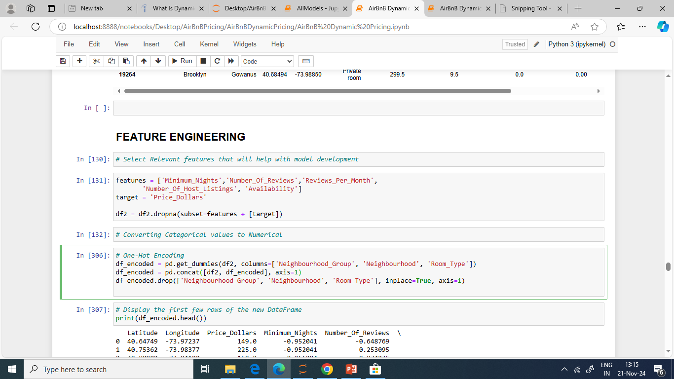
Feature engineering
Relevant features for training the dataset is selected
OneHotEncoding is done to convert categorical values to numerical values

Slide 19
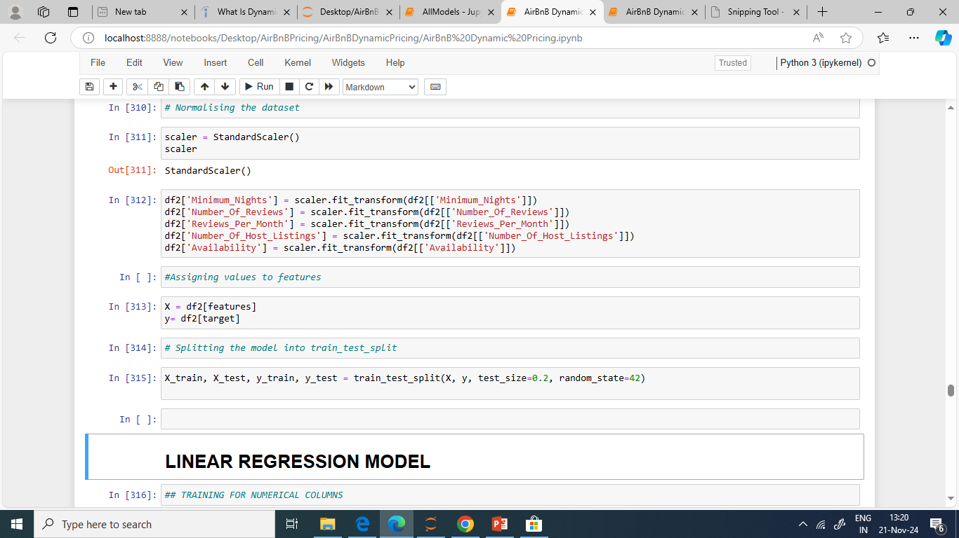
The dataset was normalized using a standardscaler
X represents the features of the dataset
Y represents the target variable
The model is split into train_test_split

Slide 20
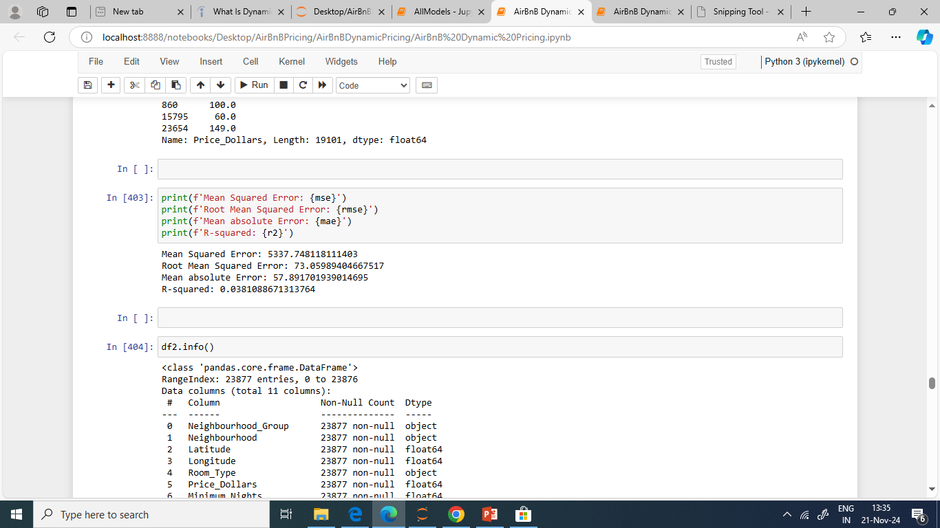
Linear regression model
Numerical values
The MSE of 5337.75 suggests that, on average, the squared difference between the predicted and actual prices is 5337.75. A high MSE means poor model performance.
RMSE of 73.06 means that, on average, the predicted prices deviate from the actual prices by about 73.06 dollars. It is the same unit as the target variable
MAE of 57.89 indicates that, on average, the predicted prices are off by about 57.89 dollars.
R-Squared of 0.038 means that only about 3.8% of the variability in the prices can be explained by the model. This suggests that the model has a low level of explanatory power and may not be capturing the underlying patterns in the data effectively.

Slide 21
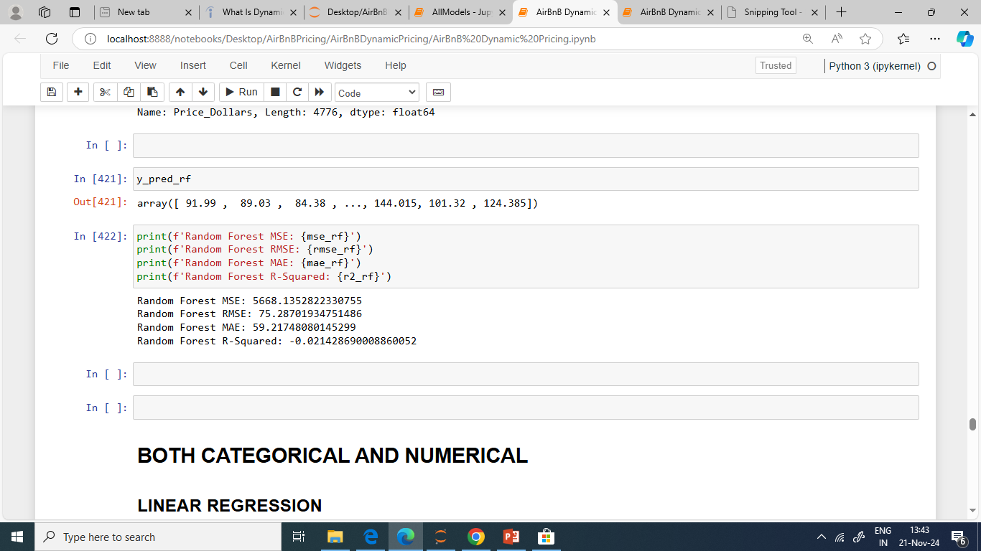
Random Forest
The MSE of 5668.14 suggests that, on average, the squared difference between the predicted and actual prices is 5668.14. A lower MSE indicates better model performance.
RMSE of 75.29 means that, on average, the predicted prices deviate from the actual prices by about 75.29 dollars.
MAE of 59.22 indicates that, on average, the predicted prices are off by about 59.22 dollars.
R-Squared of -0.021 means that the model is performing worse than a simple mean-based model. This negative value suggests that the model is not capturing the underlying patterns in the data effectively and may be overfitting or underfitting.

Slide 22
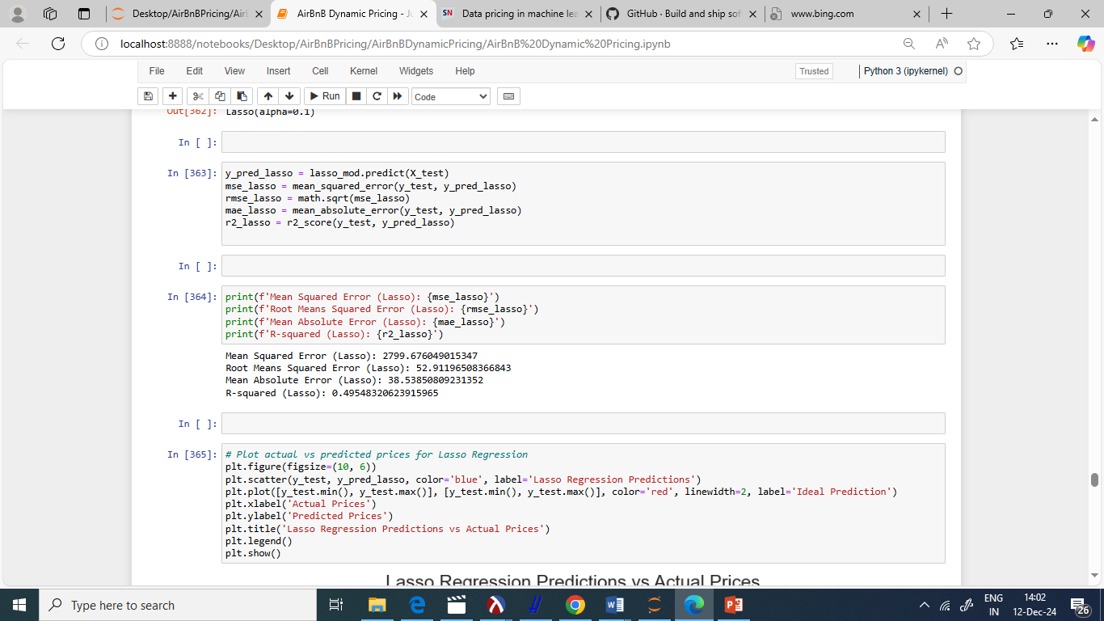
Lasso Regression Model – Both Categorical and Numerical
The MSE of 2799.68 suggests that, on average, the squared difference between the predicted and actual prices is 2799.68. Better performance is determined by a lower MSE
RMSE of 52.91 means that, on average, the predicted prices deviate from the actual prices by about 52.91 dollars.
MAE of 38.54 indicates that, on average, the predicted prices are off by about 38.54 dollars.
R-Squared of 0.495 means that approximately 49.5% of the variability in the prices can be explained by the model. This suggests that the model has a moderate level of explanatory power.

Slide 23
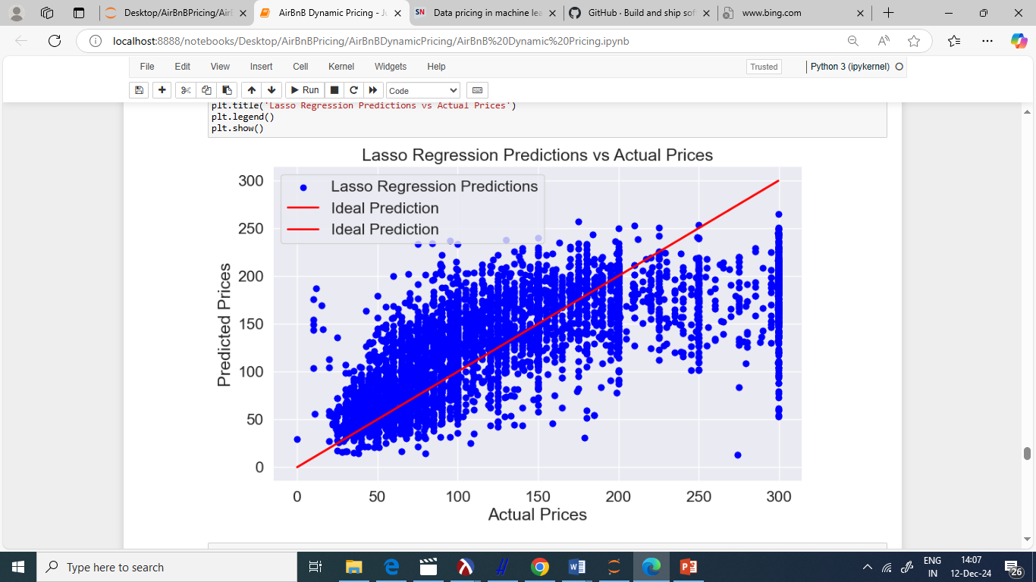
Lasso price predictions

Slide 24
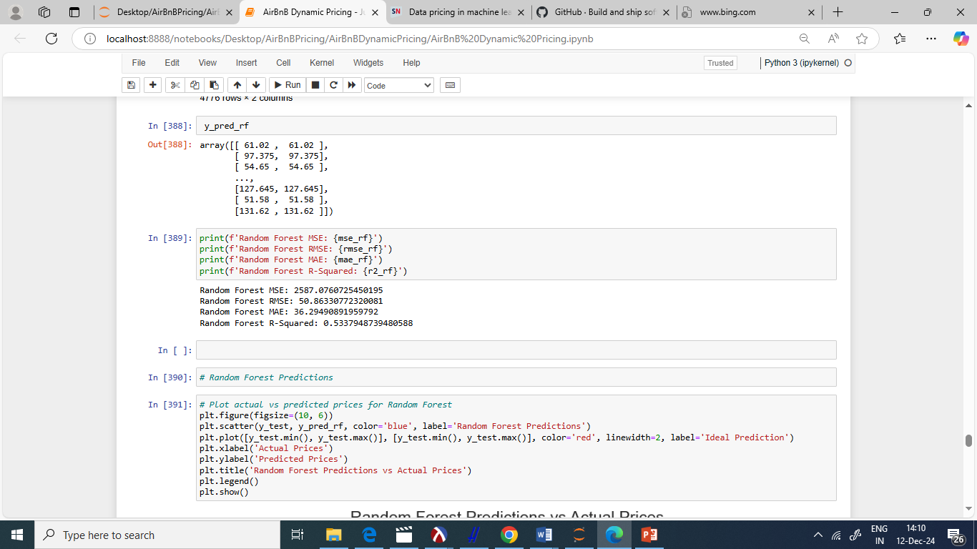
Random Forest- Categorical and Numerical
The MSE of 2587.08 suggests that, on average, the squared difference between the predicted and actual prices is 2587.08. Lower MSE indicates a high performance
RMSE of 50.86 means that, on average, the predicted prices deviate from the actual prices by about 50.86 dollars.
MAE of 36.29 indicates that, on average, the predicted prices are off by about 36.29 dollars.
R-Squared of 0.534 means that approximately 53.4% of the variability in the prices can be explained by the model. This suggests that the model has a moderate level of explanatory power.

Slide 25
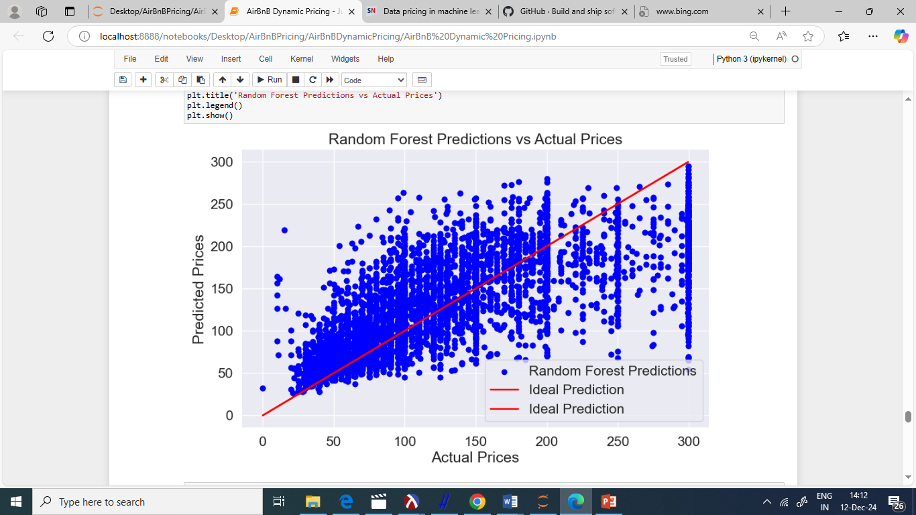
Random Forest price predictions

Slide 26
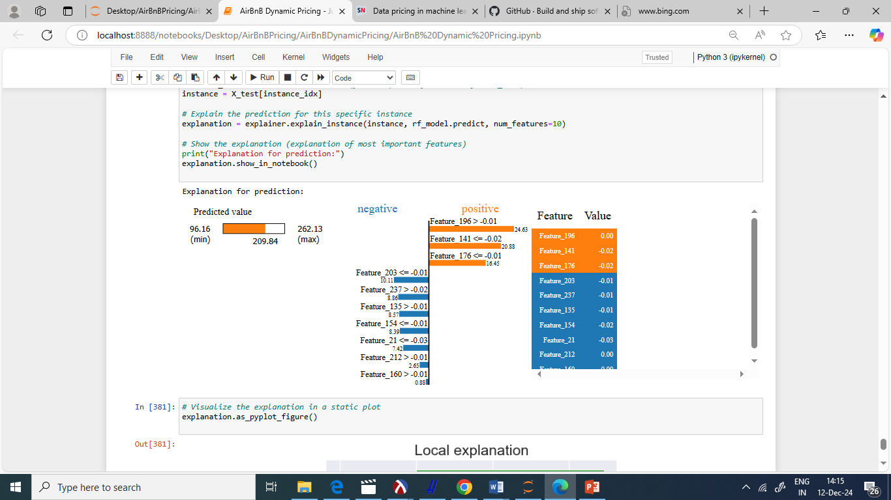
Explainable AI
Predicted Value: 96.16 is the predicted price for the selected Airbnb listing based on the features provided.

Slide 27
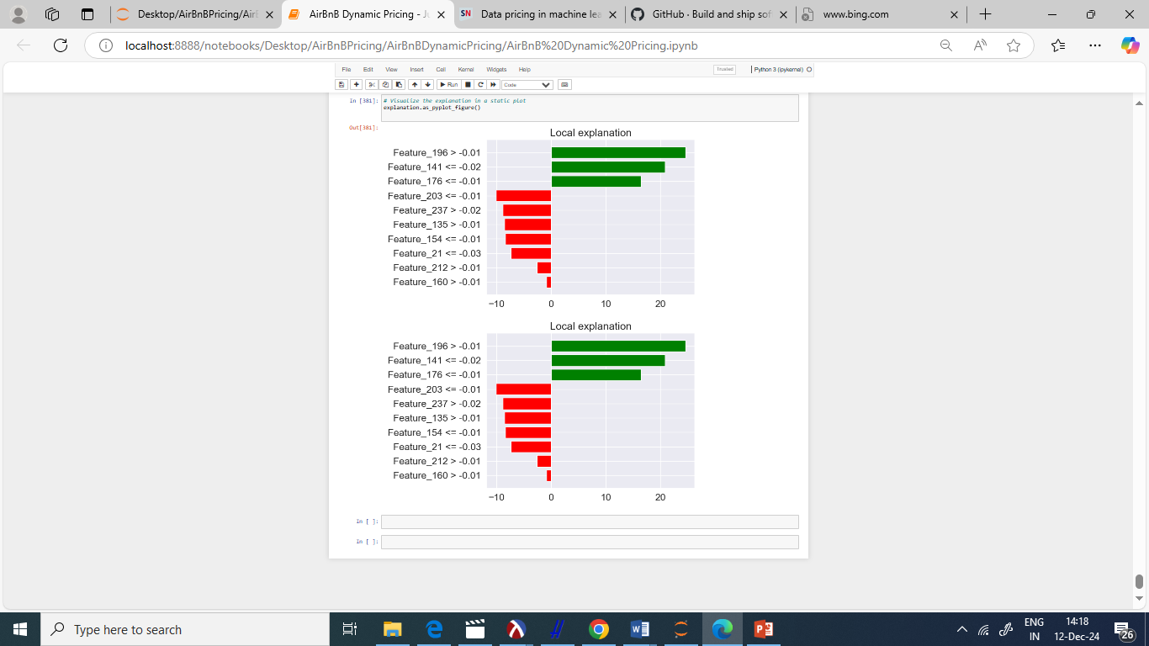
Cont…

Slide 28
Feature contributions of explainable AI
Feature_196 > -0.01
Contribution: 24.63
Value: 0.00
This feature has a positive contribution of 24.63 to the predicted price. The value of this feature is 0.00.
Feature_141 <= -0.02
Contribution: 20.88
Value: -0.02
This feature has a positive contribution of 20.88 to the predicted price. The value of this feature is -0.02.
Feature_176 <= -0.01
Contribution: 16.45
Value: -0.02
This feature has a positive contribution of 16.45 to the predicted price. The value of this feature is -0.02.
Feature_203 <= -0.01
Contribution: 10.11
Value: -0.01
This feature has a positive contribution of 10.11 to the predicted price. The value of this feature is -0.01.

Slide 29
Feature contribution continuation
Feature_237 > -0.02
Contribution: 8.86
Value: -0.01
This feature has a positive contribution of 8.86 to the predicted price. The value of this feature is -0.01.
Feature_135 > -0.01
Contribution: 8.57
Value: -0.01
This feature has a positive contribution of 8.57 to the predicted price. The value of this feature is -0.01.
Feature_154 <= -0.01
Contribution: 8.39
Value: -0.02
This feature has a positive contribution of 8.39 to the predicted price. The value of this feature is -0.02.

Slide 30
Conclusion and Future Work
In this project, we explored dynamic pricing for Airbnb listings using various machine learning models, including Random Forest, Lasso Regression, and others. Our primary goal was to develop a model that could accurately predict the optimal price for Airbnb listings based on various features such as location, demand, and availability. For further enhancement to the dynamic pricing model and to improve its accuracy, the following steps should be carried out: Additional features should be explored that could impact pricing, such as seasonal trends, local events, and economic indicators. Incorporating these features may improve the predictive power of the model.Combine multiple models using ensemble techniques like boosting, bagging, or stacking to improve overall prediction accuracy and robustness and Integrate real-time data sources to update the model continuously and adapt to changing market conditions. This can help in making more accurate and timely pricing decisions.

Slide 31
Thank You!

